Slide 1










DEADLY
DISINFORMATION
RAEANNE MILLER & KARA COUSINS

Slide 2
Learning Objectives
  To guess whodunit!
  To go over the basics of media literacy.
  To encourage you to think critically about the media you consume.
  To give you tools to analyze the media you consume.

Slide 3

WHODUNIT?
Now we’ll briefly go around the room to share our guesses.

Slide 4
OPen-Mindedness
In this conversation, we need to be open-minded. Everyone is coming from different backgrounds and value systems. This makes this subject matter difficult to discuss.
Those who study this topic state we’re moving away from people believing facts and reacting with their emotions instead, which makes it harder to get information across to people.
Notes:
This is bad. We want people to access the most accurate information possible on any subject. This contributes to a shared reality.

Slide 5
What is Media Literacy?
“Media Literacy is a 21st century approach to education. It provides a framework to access, analyze, evaluate, create and participate with messages in a variety of forms — from print to video to the Internet. Media literacy builds an understanding of the role of media in society as well as essential skills of inquiry and self-expression necessary for citizens of a democracy.”
https://www.medialit.org/media-literacy-definition-and-more/
Notes:
From The Center for Media Literacy.

Slide 6

Which is the least Harmful? Which is the most Harmful?
  Falsehood
  Fabrication
  Misinterpretation
  Misrepresentation
  Alternative Fact
  Lie
  Fake News
Notes:
The reason I asked you about those phrases is to bring up the issue of language. These results show that the possibility of getting different results, based on who you ask, when you ask, and that person's background. Language is fluid.
Two terms I want to focus on are mis/disinformation.

Slide 7
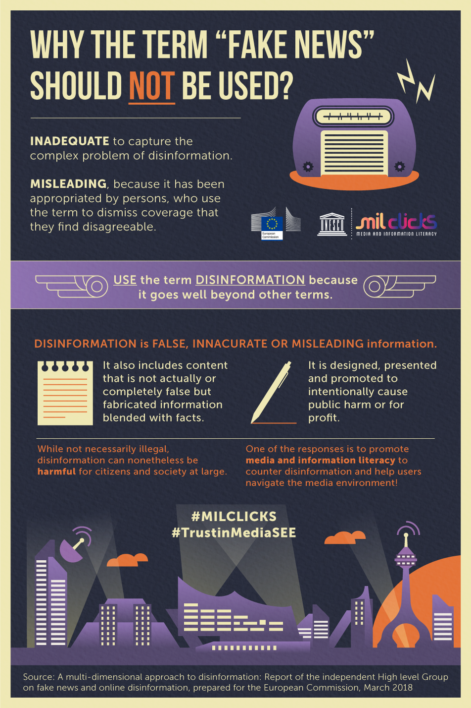
Moving Away from fake news
https://www.facebook.com/MILCLICKS/photos/pb.100064672273204.-2207520000/1690548134324174/?type=3
Notes:
We want to avoid using the phrase 'fake news' because it's become a very polarizing phrase. It's often a way that people shut down conversations. This is why we didn't name this program 'How to spot fake news'. The use of this phrase is partly why mis/disinformation easily spreads, because information is dismissed and shared without being vetted.

Slide 8
Definitions
  Misinformation - the sharing of inaccurate and misleading information in an unintentional way.
    Typo, wrong word in a headline, inaccurate context, etc.
  Disinformation - the deliberate dissemination of false or inaccurate information in order to discredit a person or organization.
https://library.csi.cuny.edu/misinformation#s-lg-box-13619221
Notes:
Misinformation = false
Disinformation = false, but deliberate (we see more of it)

Slide 9
Our Examples of Mis/Disinformation
  Disinformation - Tabloid
    Tabloid wanted to make money off of a sensational headline, and Tom wanted a source to spread his cover up.
  Misinformation - The Denver Chronicle
    Incorporated information from the tabloid without vetting.

Slide 10
Real Examples of Mis/Disinformation
  Disney parks drinking age & the Jan 6th Riots
    Central Washington State Library breakdown
  The University of Idaho Murders
    News Clip

Slide 11
Tools to analyze media
Stay Curious!
Questions to ask:
  Who made this and for what purpose?
  Who paid for this?
  Whose voices are included and whose are left out?
  Was this crafted to trigger emotions, if so, how and why?
  When was this created and how was it shared?
  Is this a trustworthy source about this particular topic?
  Who might this message benefit? Who might it harm?
  Do I have an open mind about this? Why or why not?
projectlooksharp.org

Slide 12
Tools to analyze media Continued
  PolitiFact
  Factcheck.org
  Washington Post Fact Checker
  Snopes
  Fact Check from Duke Reporters’ Lab
  SciCheck
  Flack Check
  Media Bias/Fact Check
  NPR FactCheck

Slide 13
Sources
  Burga, S. (2023). Idaho murders show the cost of the U.S. True Crime Addiction. Time. https://time.com/6250031/idaho-murders-true-crime-addiction/
  Cooke, N. A. (n.d.). Media literacy for adults: Misinformation and disinformation. Media Literacy for Adults: Misinformation and Disinformation | Programming Librarian. https://programminglibrarian.org/learn/media-literacy-adults-misinformation-and-disinformation
  CSI Library: Misinformation and disinformation: Thinking critically about information sources: Misinformation, disinformation, and malinformation. Misinformation, Disinformation, and Malinformation - Misinformation and Disinformation: Thinking Critically about Information Sources - CSI Library at CUNY College of Staten Island Library. (n.d.). https://library.csi.cuny.edu/misinformation#s-lg-box-13619221
  Libguides: Misinformation, disinformation, and propaganda: Fake news infographic. Fake News Infographic - Misinformation, Disinformation, and Propaganda - LibGuides at Cornell University. (2024). https://guides.library.cornell.edu/evaluate_news/infographic
  Libguides: Misinformation & Fake News: Case Studies & Examples. Case Studies & Examples - Misinformation & Fake News - LibGuides at Central Washington University. (n.d.). https://libguides.lib.cwu.edu/c.php?g=625394&p=4391900
  Media Literacy: A definition and more. Media Literacy: A Definition and More | Center for Media Literacy | Empowerment through Education | CML MediaLit Kit TM |. (n.d.). https://www.medialit.org/media-literacy-definition-and-more
  Project look sharp. Project Look Sharp. (n.d.). https://projectlooksharp.org/our-approach.php#videos

